Slide 1


Hadoop and Spark – Perfect Together
®
®
Jeff Markham, Technical Director, APAC

Slide 2

Data Operating System
Enable all data and applications TO BE accessible and shared BY any end-users

Slide 3

Data Operating System: Open Enterprise Hadoop
Hadoop/YARN-powered data operating system
100% open source, multi-tenant data platform for
any application, any data set, anywhere.
Data access: batch, interactive, real-time
Resource management
Governance
Security
Built on a centralized architecture of
shared enterprise services:
Scalable tiered storage
Resource and workload management
Trusted data governance & metadata management
Consistent operations
Comprehensive security
Developer APIs and tools
YARN: data operating system
Operations
Storage
Commodity
Appliance
Cloud

Slide 4

Why We Love Spark at Hortonworks
Elegant Developer APIs DataFrames, Machine Learning, and SQL
Interactive Data Science All apps need to get predictive at scale and fine granularity
Democratize Machine Learning Spark is doing to ML on Hadoop what Hive did for SQL on Hadoop
Community Broad developer, customer and partner interest
Realize Value of Data Operating System A key tool in the Hadoop toolbox
Resource Management
Governance
Security
YARN: Data Operating System
Operations
Storage

Slide 5
Spark and Hadoop – How Can We Do Better?
Resource Management YARN for multi-tenant, diverse workloads with predictable SLAs
Tiered Memory Storage HDFS in-memory tier for off-heap RDD cache
SparkSQL & Hive for SQL Interop with modern metastore, HS2; optimized ORC support
Spark & NoSQL Deep integration with HBase via RDDs for predicate pushdown
Connect The Dots – Algorithms to Use-Cases Higher-level ML abstractions - Validation, tuning, pipeline assembly... e.g. GeoSpatial
Ease of Use Apache Zeppelin for interactive notebooks
Resource Management
Governance
Security
YARN: Data Operating System
Operations
Storage

Slide 6
Spark and Hadoop – How Can We Do Better?
Metadata & Governance Apache Atlas for metadata & Apache Falcon support for Spark pipelines
Security & Operations Apache Ranger managed authorization and deployment/management via Apache Ambari
Deployable Anywhere Linux, Windows, on-premises or cloud
Self-Service Spark in the Cloud Easy launch of Data Science clusters via Cloudbreak and Ambari – for Azure, AWS, GCP, OpenStack, Docker
Resource Management
Governance
Security
YARN: Data Operating System
Operations
Storage

Slide 7

Let’s talk Real-World Use-Cases

Slide 8


Truck Fleet Use Case: Real-time, Predictive App
Chief Data Officer’s Needs
Application Team’s Response
Increase safety and reduce liabilities
Anticipate driver violations BEFORE they happen and take precautionary actions
Enrich app with weather data and driver profiles
Explore data for predictive model features
Train and generate predictive model
Plug in model to original application so it can predict driver violations in real-time

Slide 9
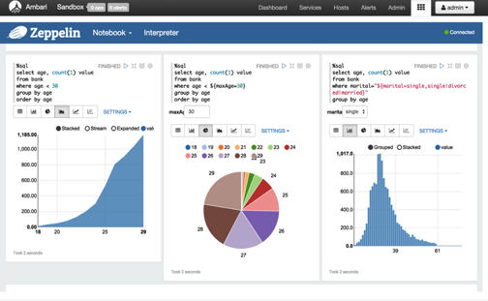

Data Scientist: Explore Data & Build Model in Cloud
Click-thru Demo
Provision data science environment in the cloud
Use data science notebook to explore data
Run algorithms to create predictive model
Cloudbreak
Choose a cloud
Pick the Spark blueprint
Launch HDP
Microsoft Azure

Slide 10
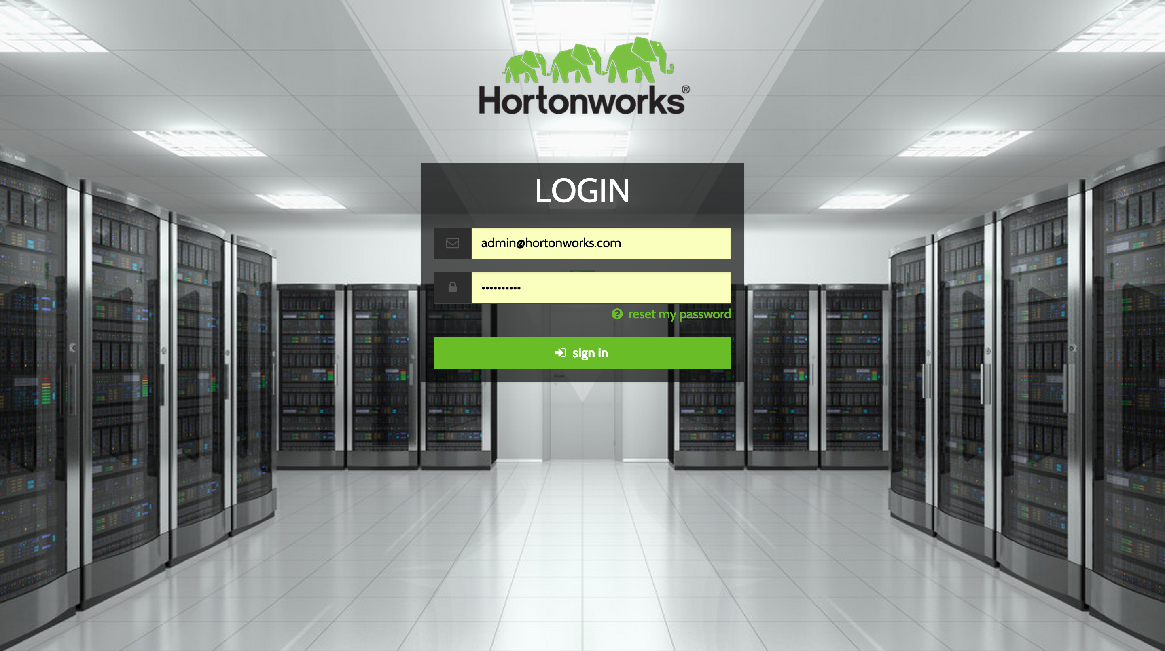
Login to launch.hortonworks.com which is a self-service portal for launching HDP clusters to the cloud
Notes:
1

Slide 11
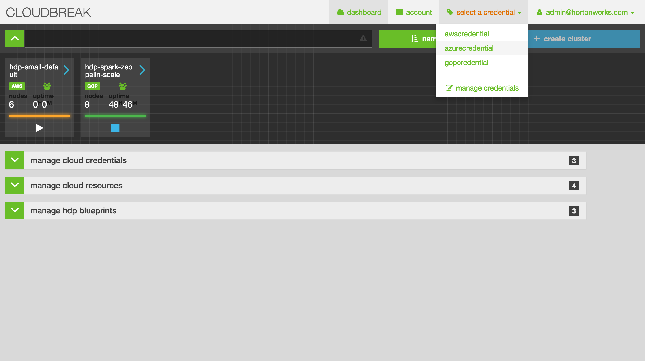
Select a cloud provider, then start the process of creating your cluster
Notes:
3

Slide 12
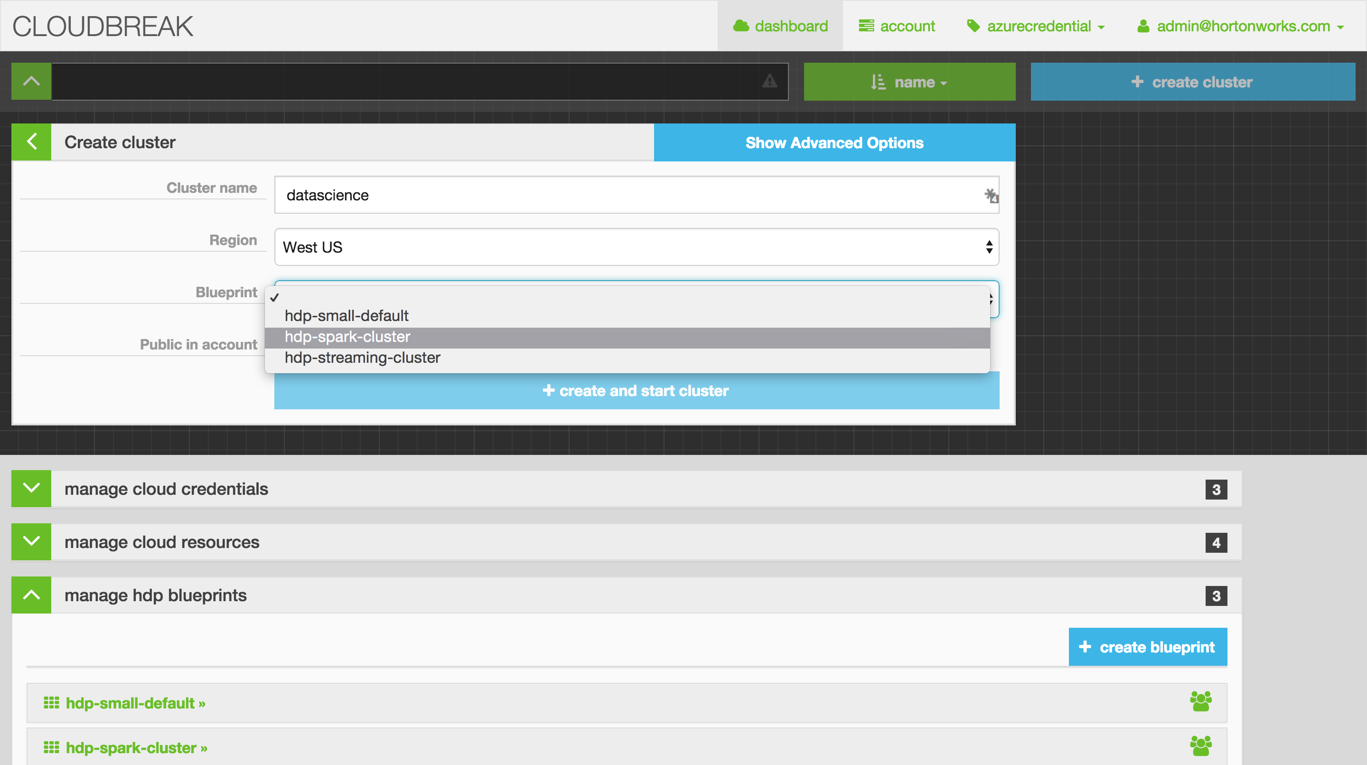
Name the cluster, choose your region, and pick your blueprint…in this case, we want “hdp-spark-cluster” for our data science work
Notes:
6

Slide 13
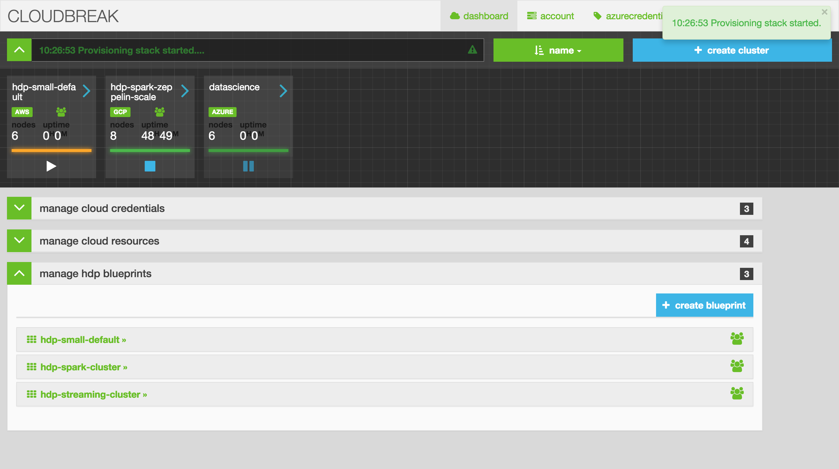
We clicked “create cluster” and Cloudbreak is now provisioning our Spark environment on Azure
Notes:
9

Slide 14
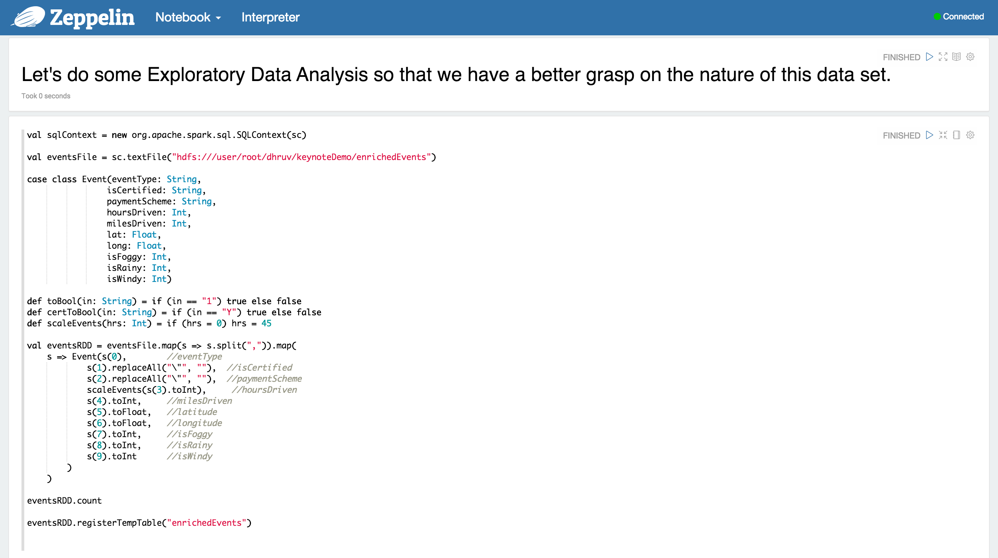
We can now access Zeppelin which is a data science notebook for Spark that’s similar to iPython notebook
Notes:
11

Slide 15
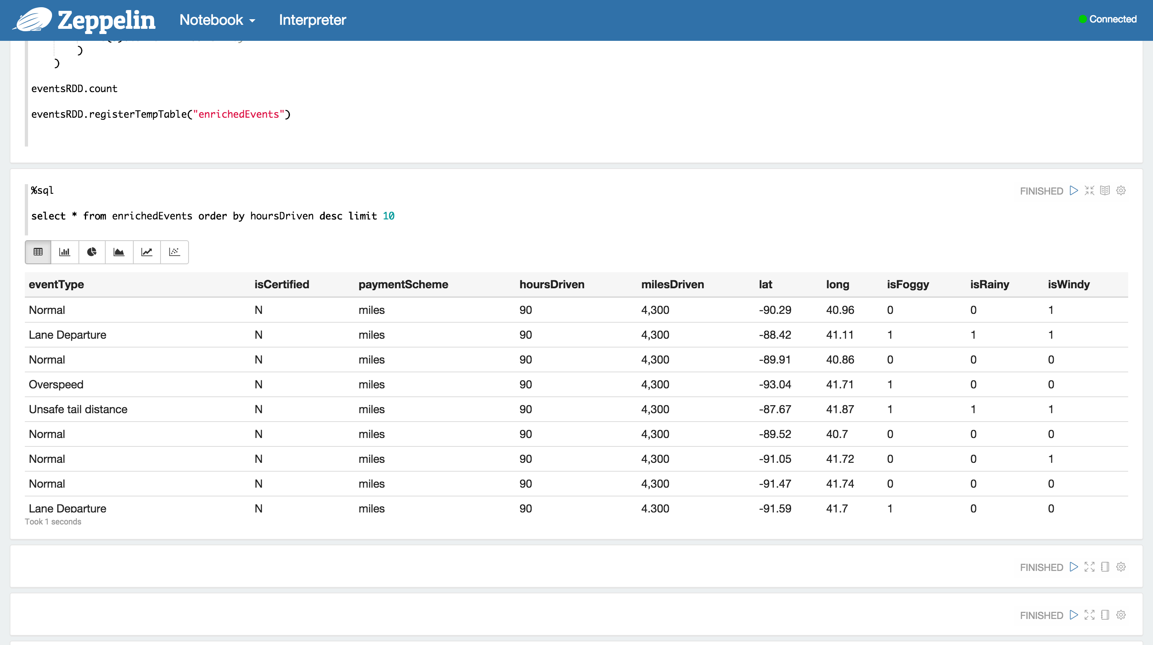
Let’s look at our data. We can see eventType, if the driver’s certified, how many hours driven, as well as weather data such as foggy, rainy, etc.
Notes:
12

Slide 16
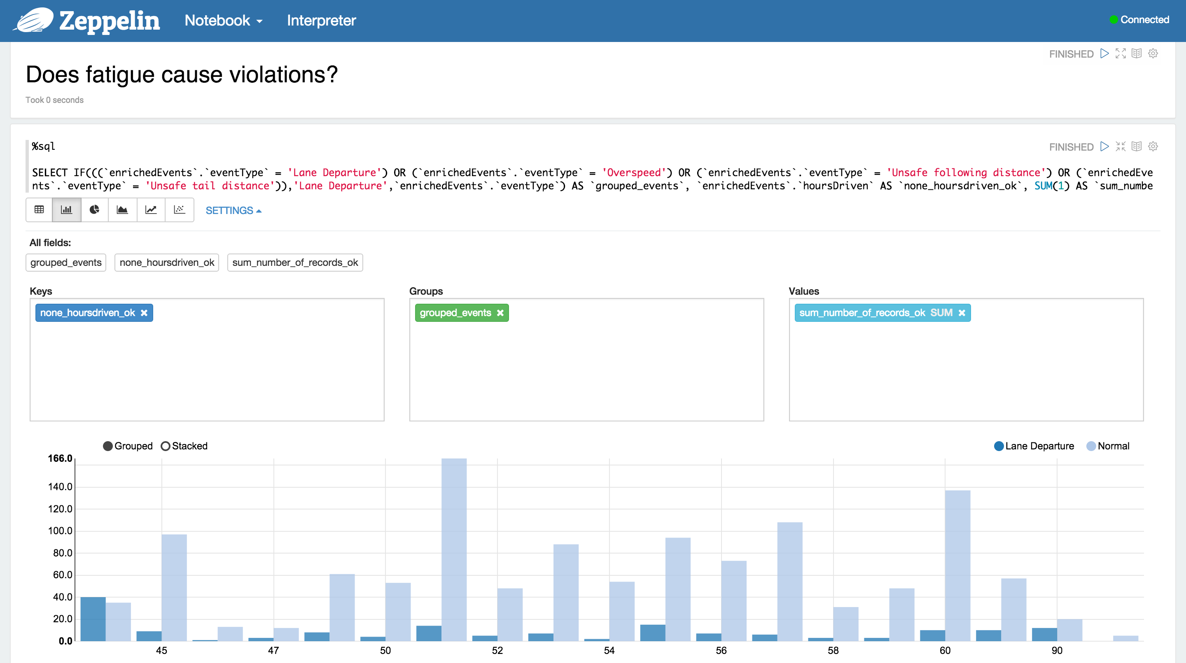
Let’s start asking questions of our data; such as, does fatigue cause violations?
Notes:
13

Slide 17
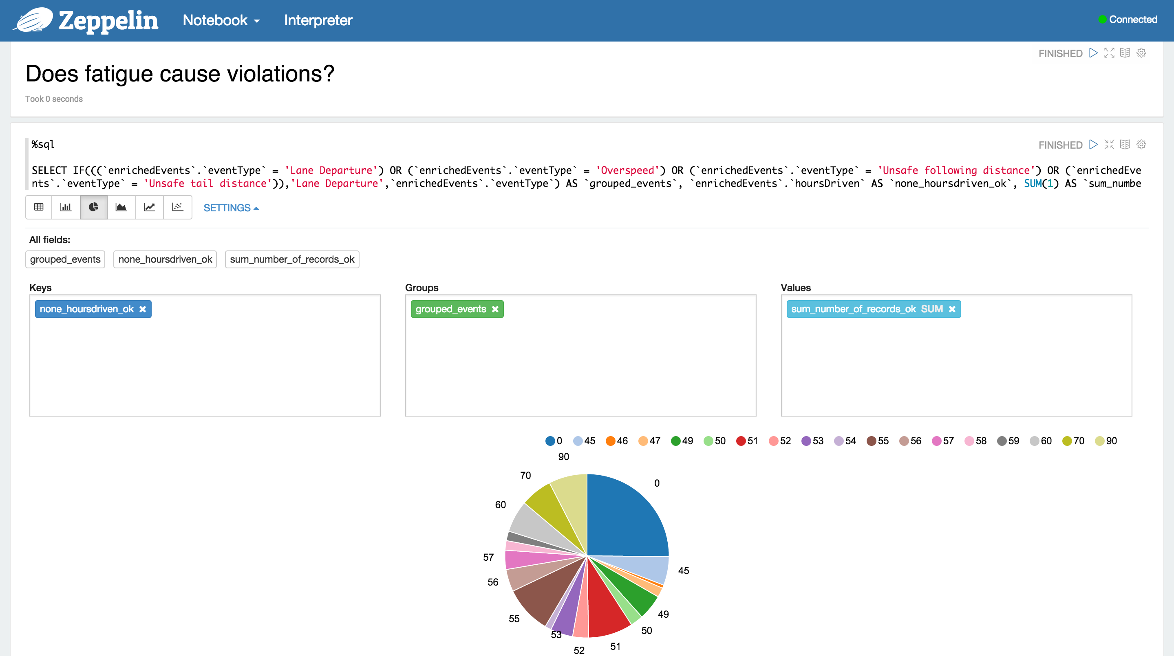
Let’s view the data in a pie chart graphic to see how violations look by hours driven.
Notes:
14

Slide 18
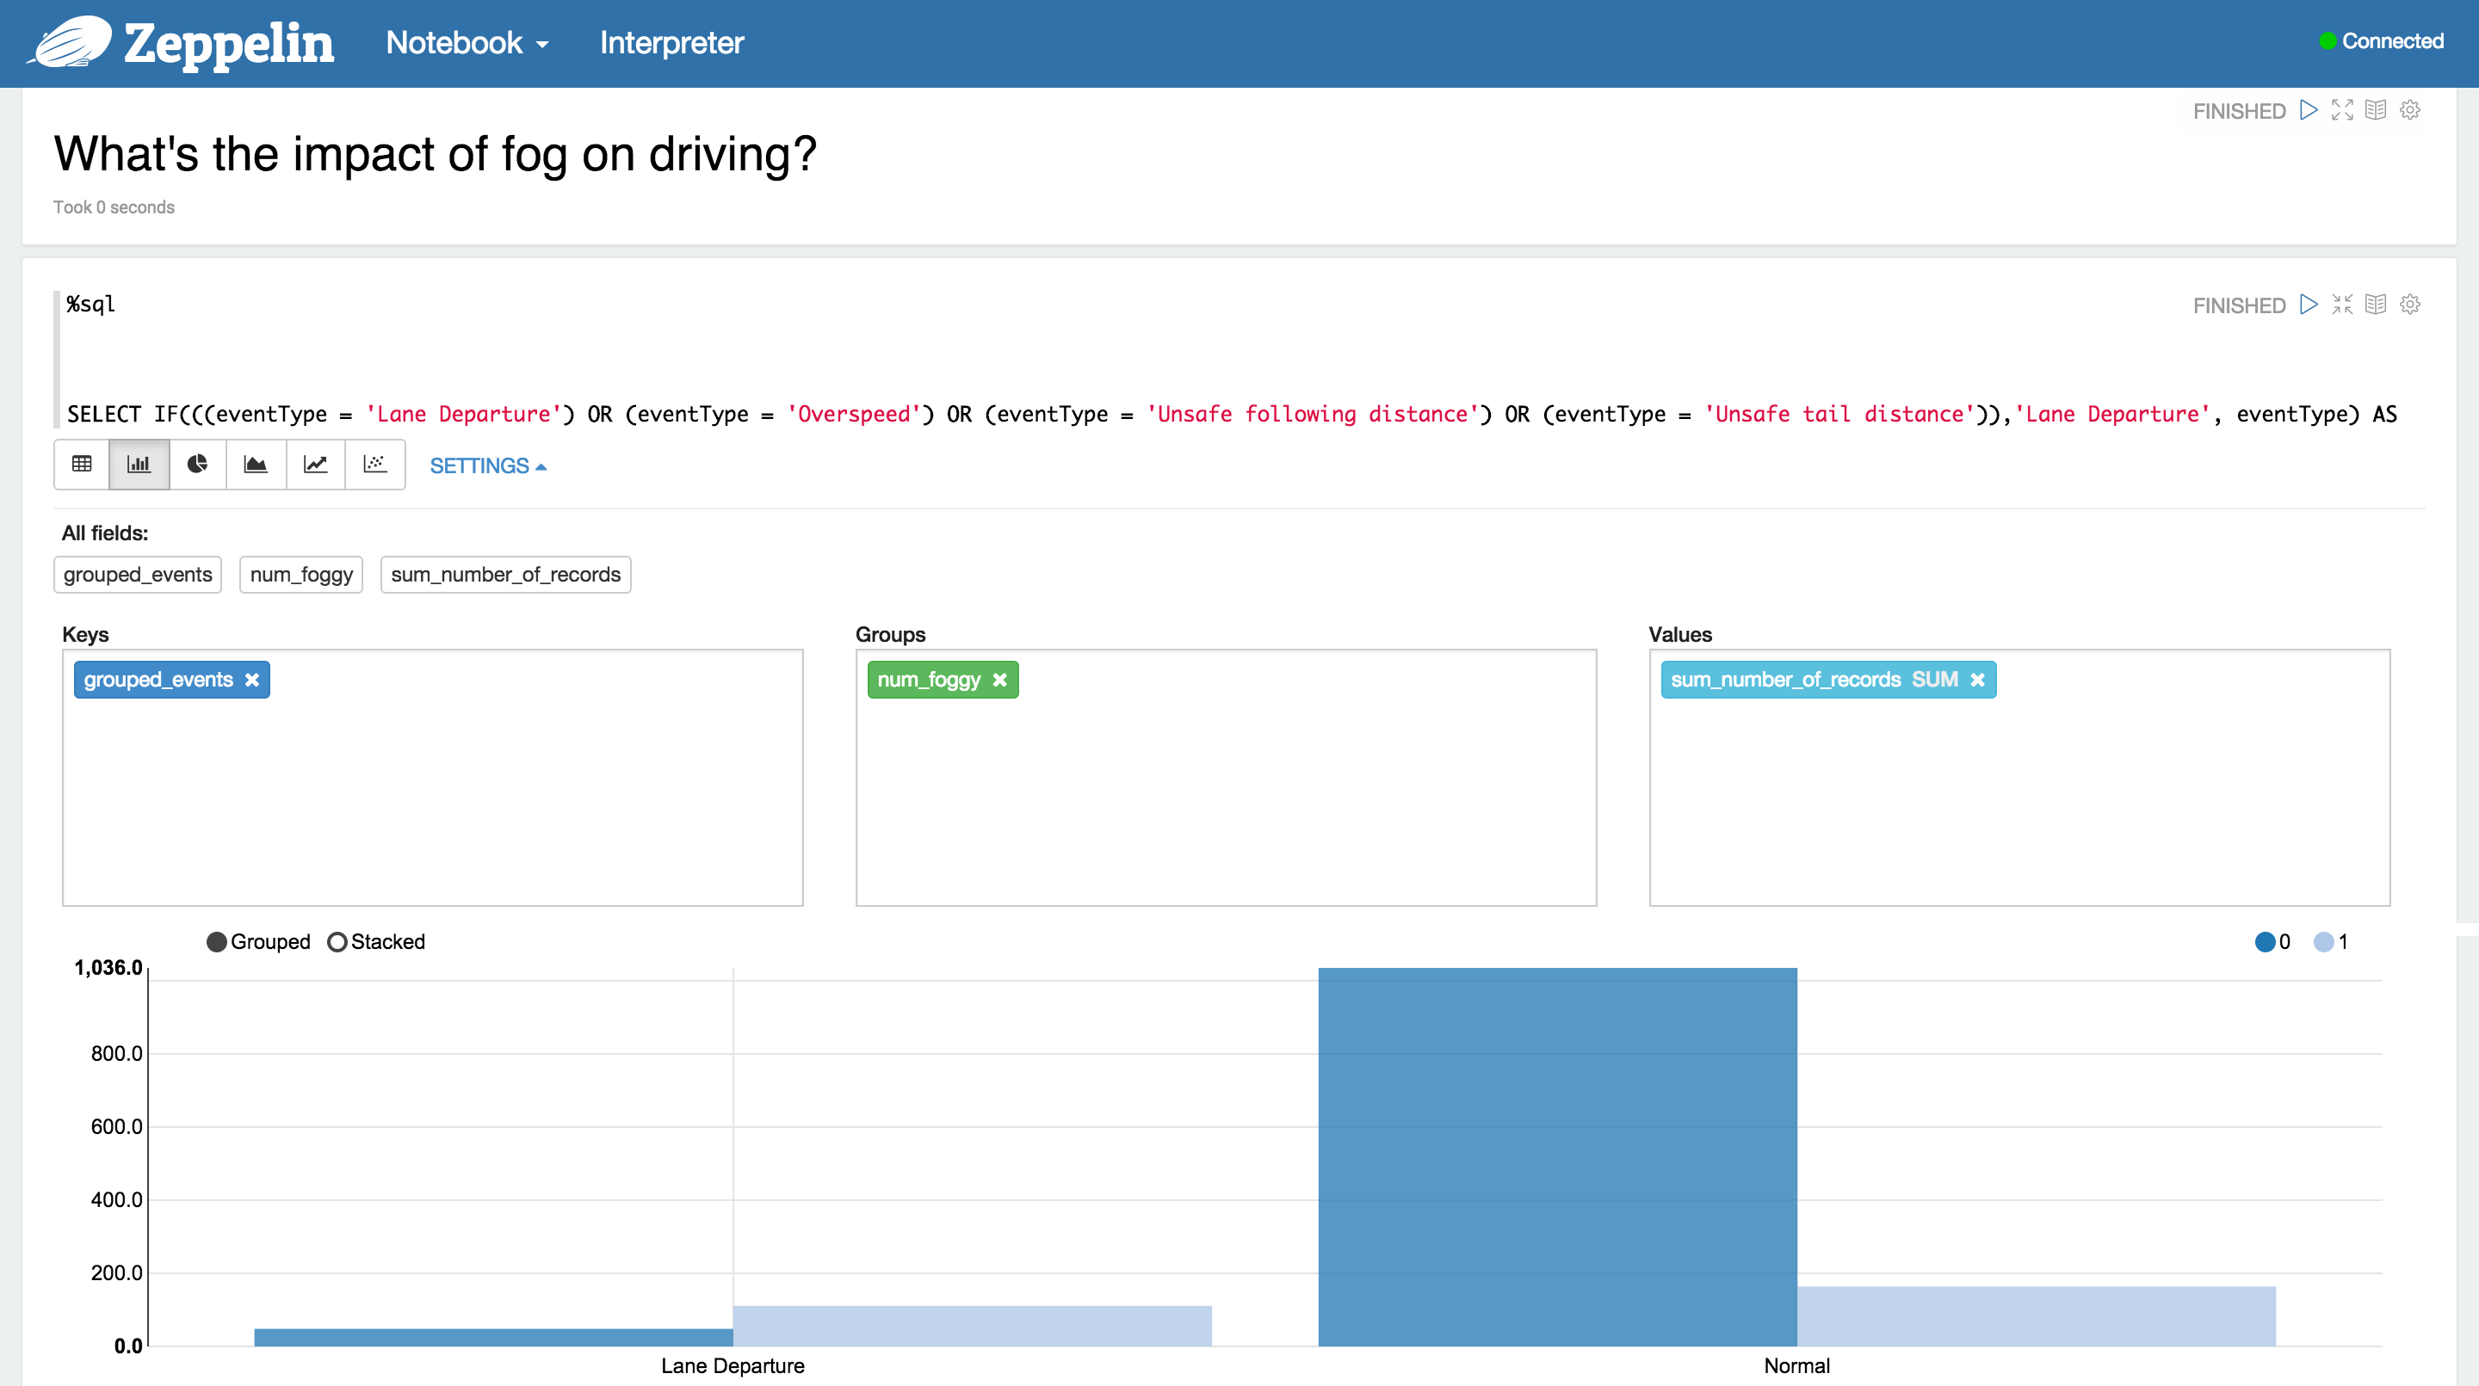
How are violations impacted by fog?
Notes:
15

Slide 19
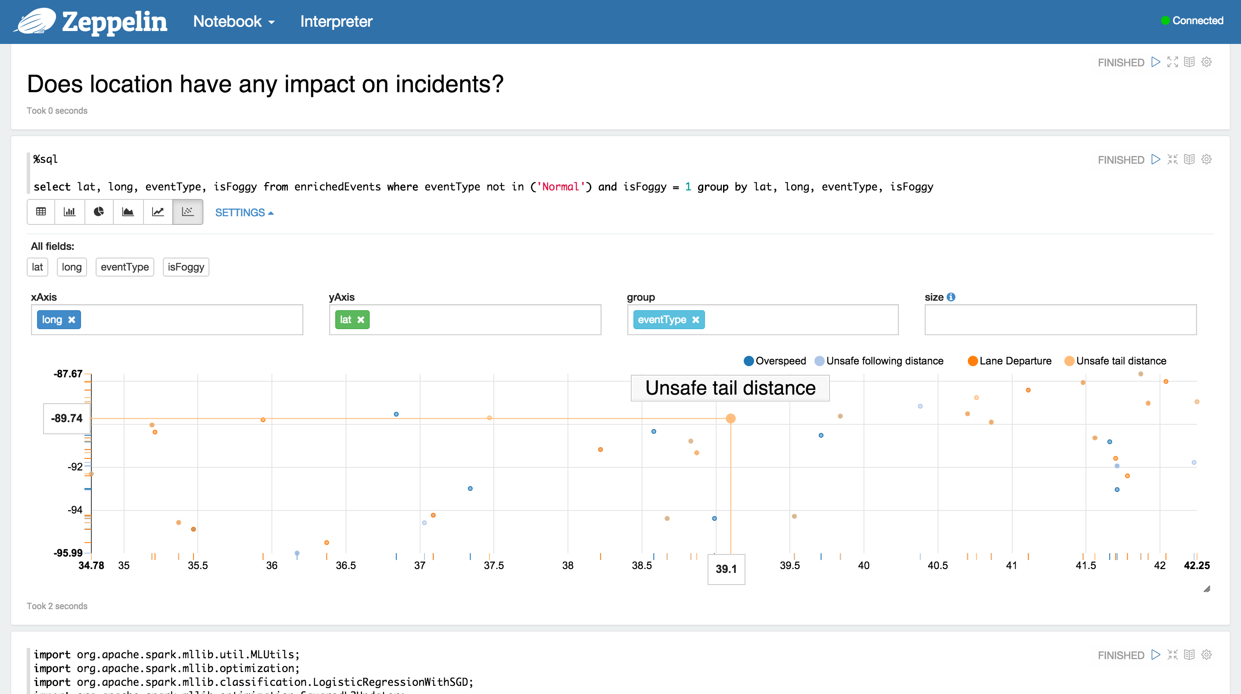
Does location have an impact on incidents?
Notes:
16

Slide 20
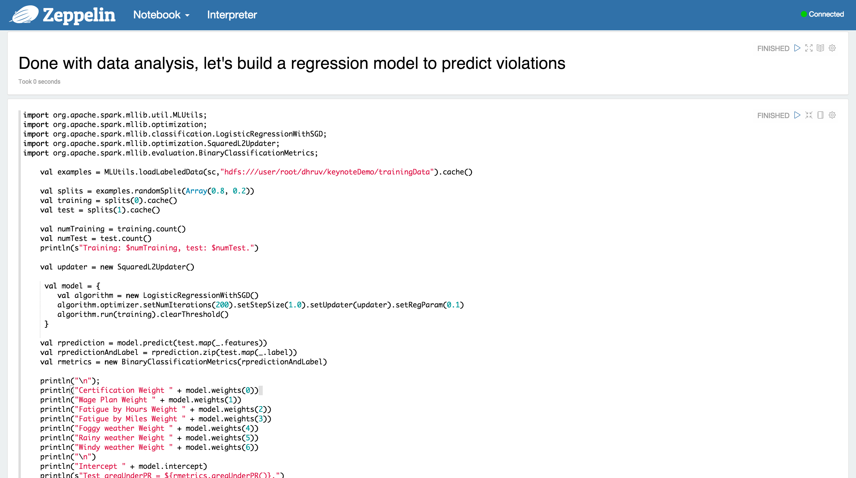
OK, we’ve learned enough about the data and what features we want to include in our model. So we’ll run a logistic regression on training data.
Notes:
17

Slide 21
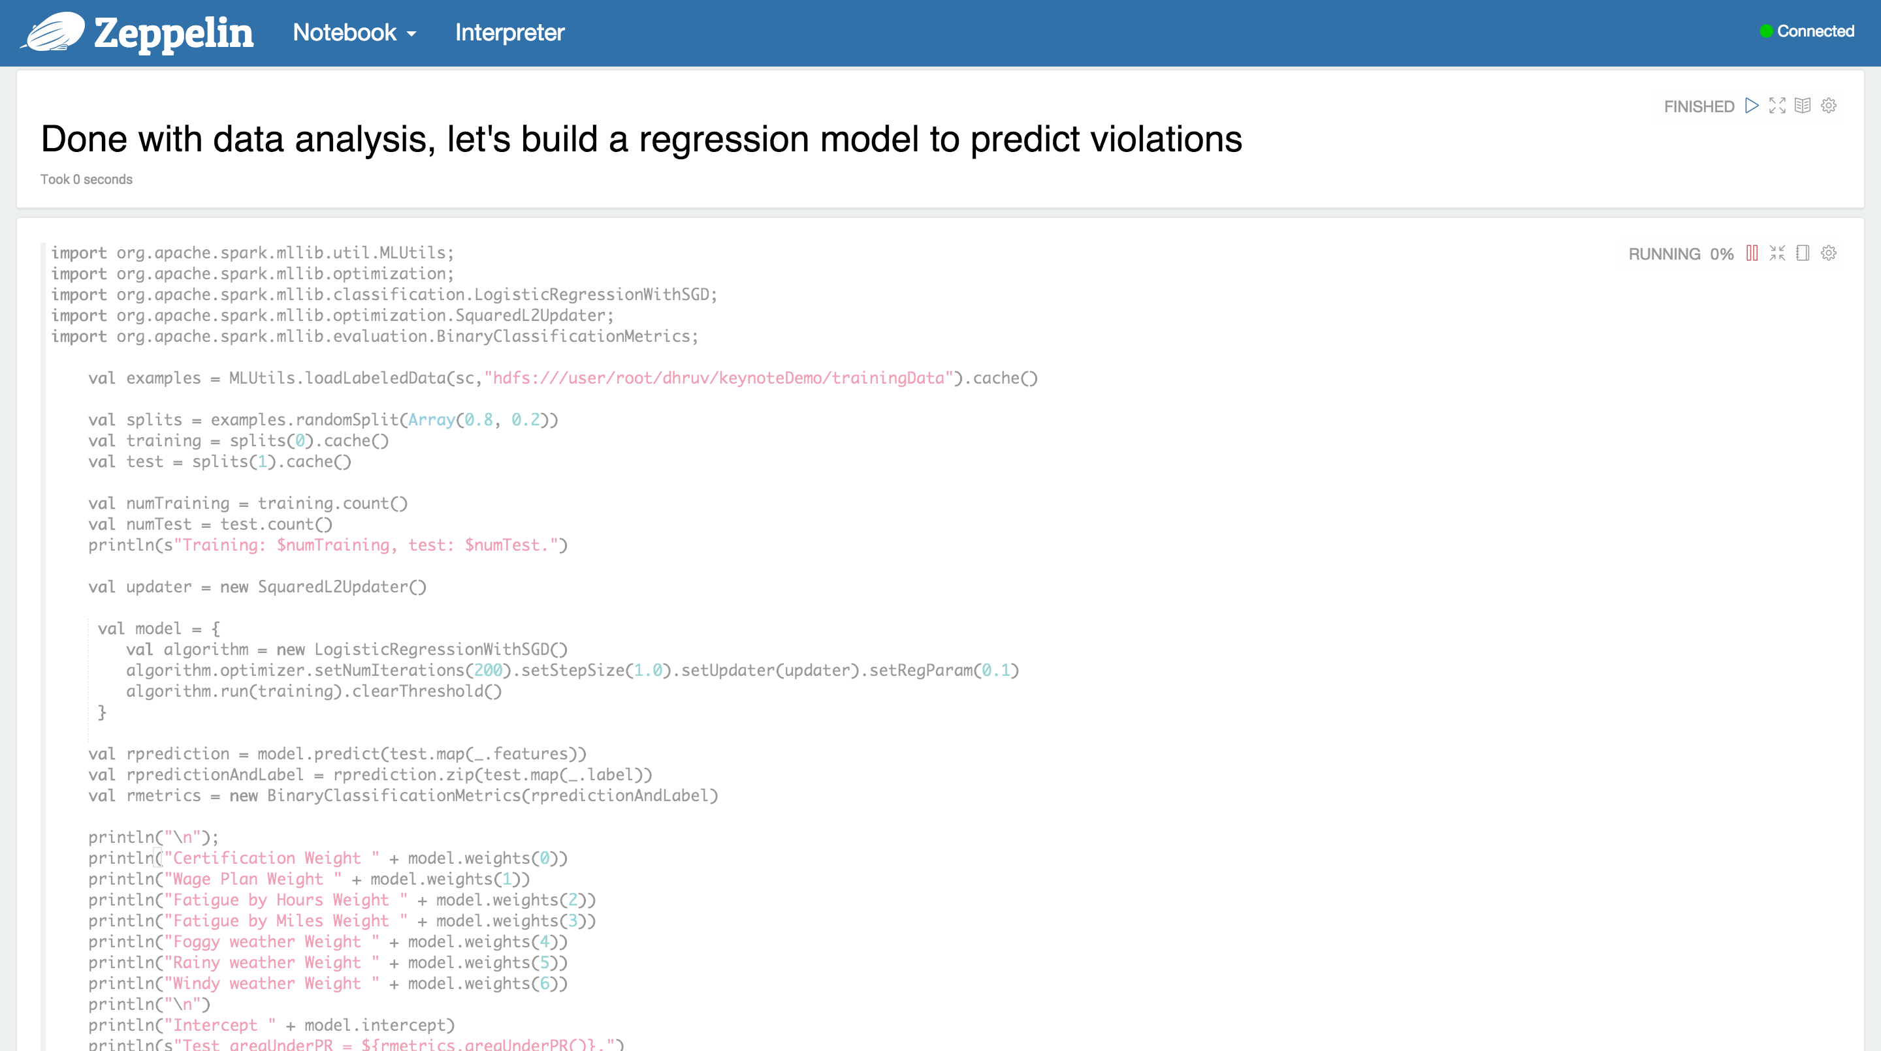
Let’s run our code
Notes:
18

Slide 22
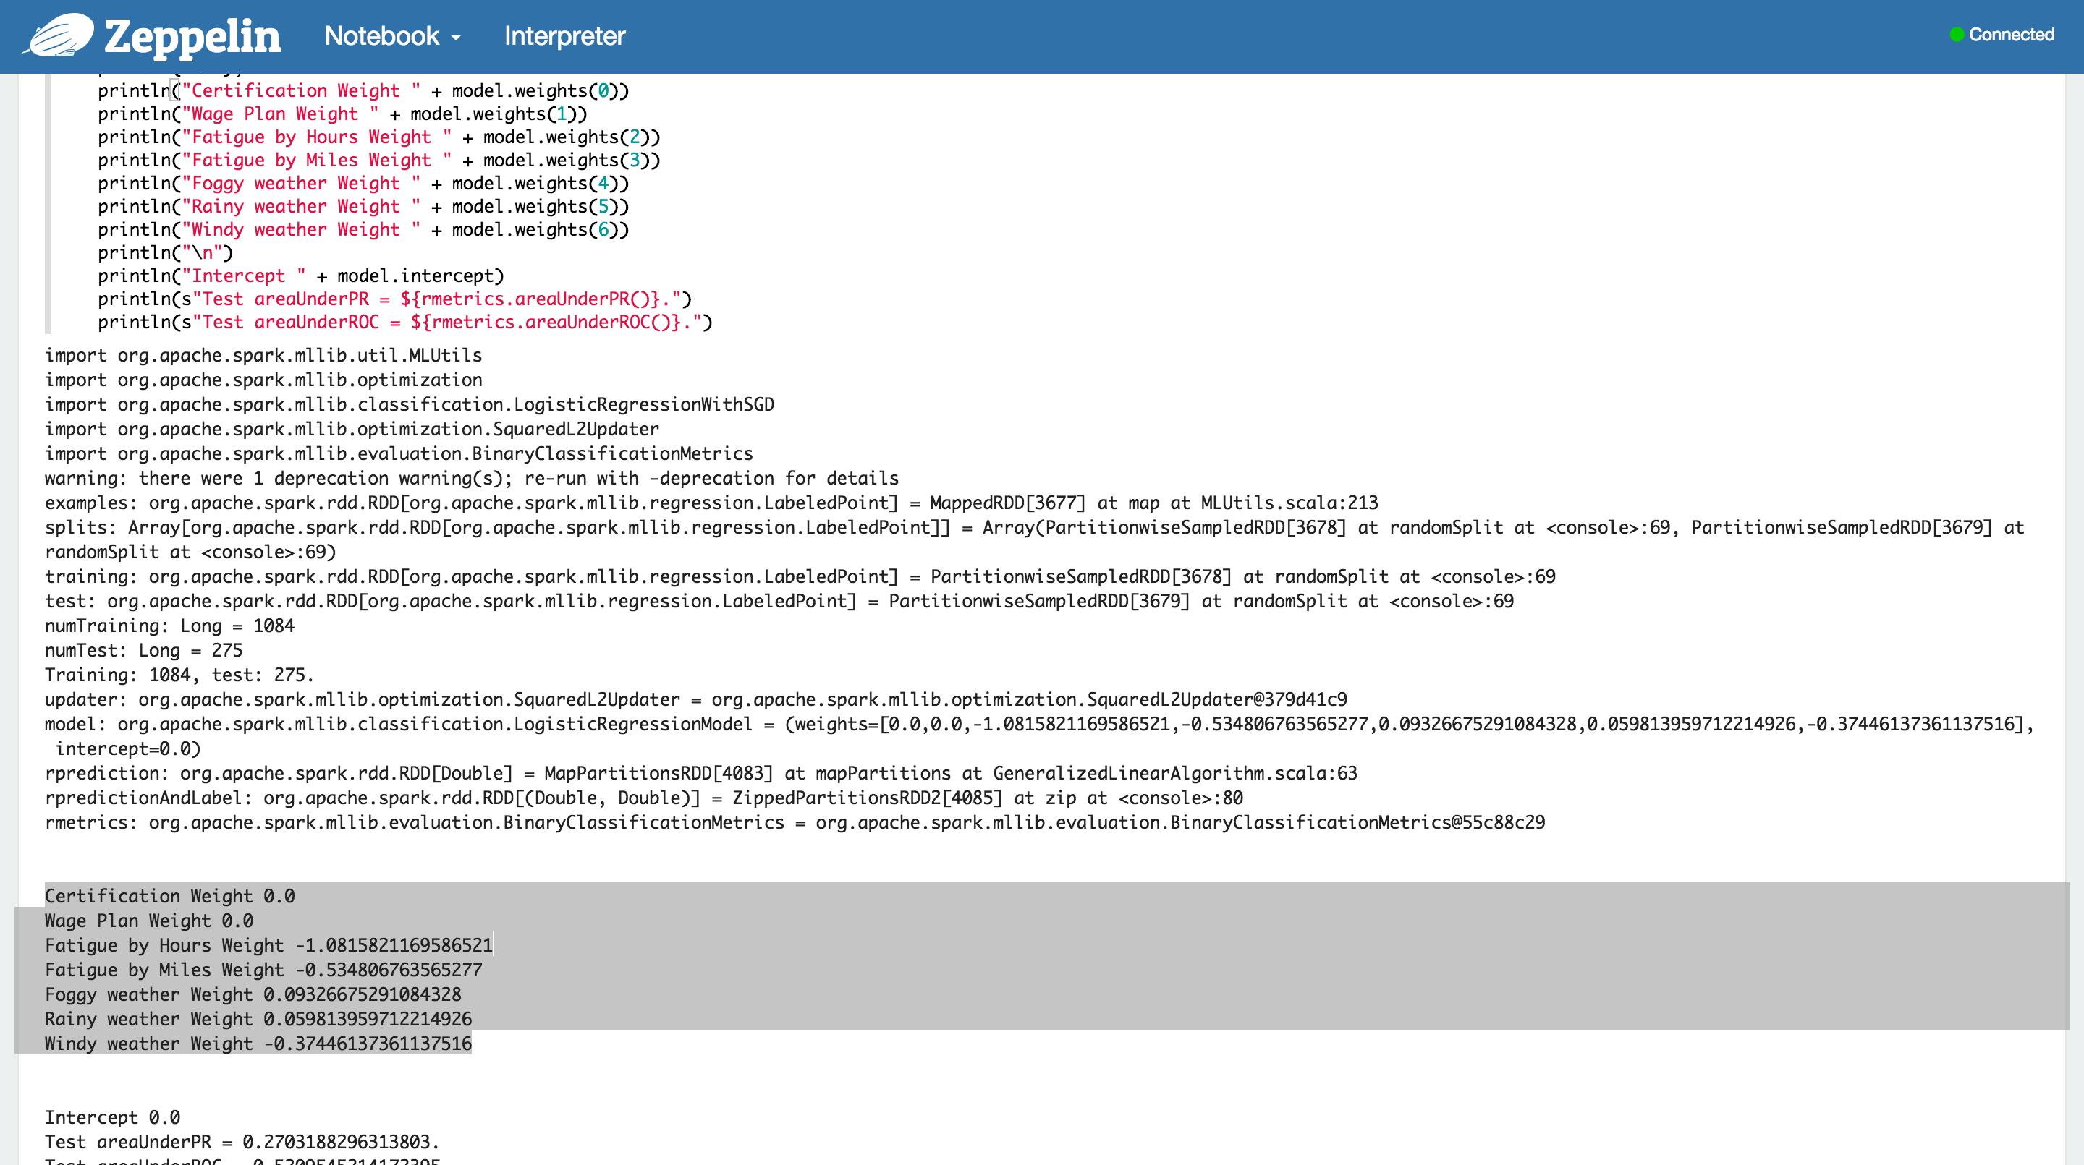
Let’s look at our model.
Next step is to hand the model off to the Enterprise Architect to integrate into our real-time application.
Notes:
20

Slide 23



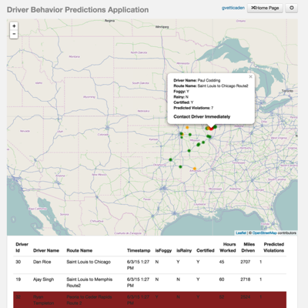




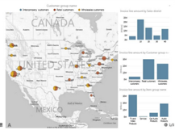

Real-time and Predictive Application Architecture
Truck sensors
Messages
Predictive application
App alerts
(ActiveMQ)
SQL
ML
Stream
NoSQL
Apps on YARN
Your BI Tool
Use
Model
Trucking company datasets stored in HDFS

Slide 24

HDP and Spark…
Perfect Together

